Slide 1
React JS Lifecycle
With Diagram Representation

Slide 2
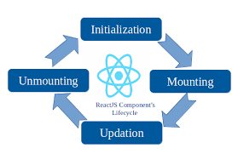
React Component Lifecycle Diagram

Slide 3
Lifecycle Phases Explanation
1. **Mounting** – The component is created and inserted into the DOM.
2. **Updating** – Component re-renders when props or state change.
3. **Unmounting** – The component is removed from the DOM.

